Slide 1

Changed Food Habits :
Assignment no - 01
Pratik Jadhav

Slide 2
Problem Statement
“To get the data from the users through Google form and analyse and find out the food which is being most eaten by the people during COVID-19 Pandemic.”
-----------------------------------------
Refer below Hint Questions for user :
Name of the food you took in Lunch most often?
What is the quantity of Rice you purchased last time?
Select appropriate question in numerical format to help your analysis.

Slide 3
Raw Data Collection
Created a Google form with certain no of questions to collect raw data from users.
Types of Questions Asked :
Name and Age Group of User.
Covid Infection Status.
Best Energy Source for people.
Multiple Answer Questions for more clarity.
Food and Fruit consumption ratio etc.
Click below link for Data Collection from people :
Survey Link

Slide 4
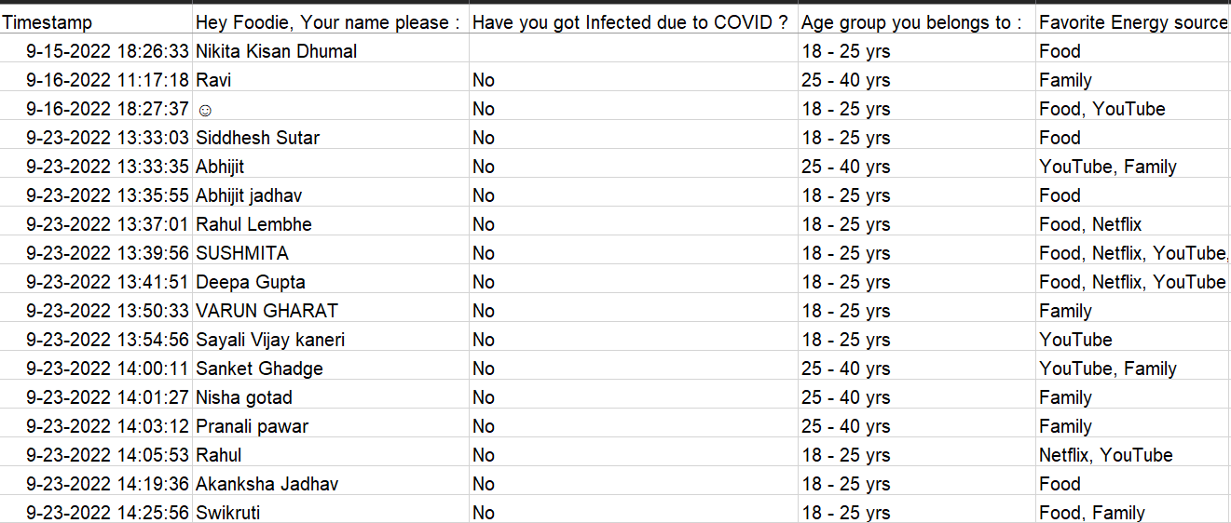
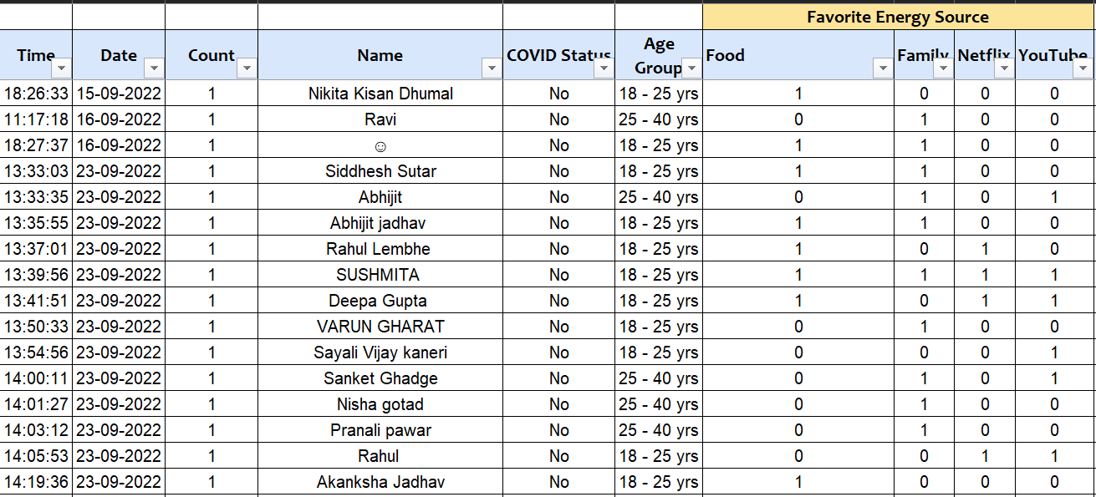
Clean Data
Formatting and Correction for the spelling mistakes if any has been checked and data is represented in proper distinguish format.
Refer below Snip :
Raw Data
Clean Data

Slide 5
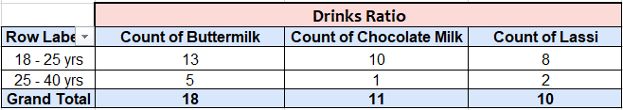
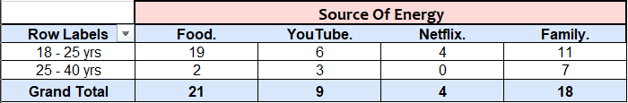
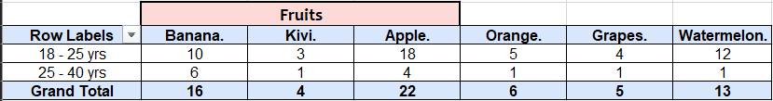
Analysis
Summarize the clean data with the help of Pivot Tables and its accessories like slicer for filtering the data as per questions.
Our Analysis :
Total No of users responded : 31 nos.

Slide 6
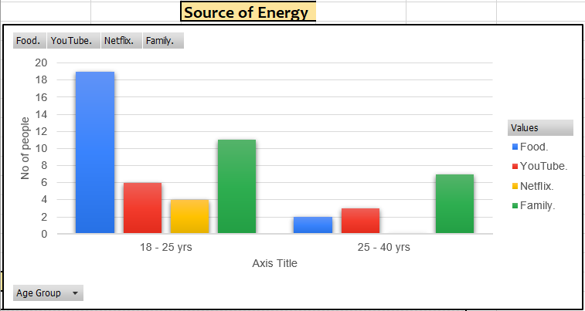
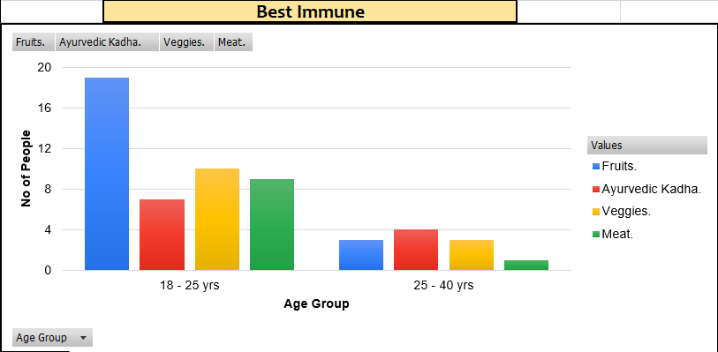
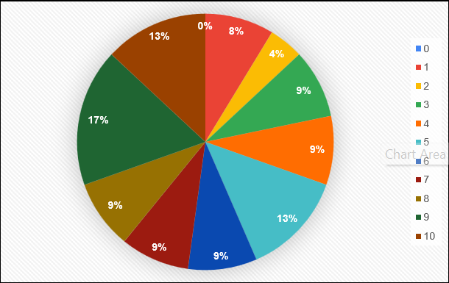
Reports..
Final Visualization of the Data as per the Questions.
Habits Changed Ratio :

Slide 7


